Slide 1
SECRET KEY EXTRACTION USING CHANNEL IMPULSE RESPONE
PROJECT BY
I. ARULRAJ (II YR ME)
412512405002
GUIDED BY
MR.M.BALAMURUGAN M. Tech
Assistant Professor

Slide 2
OBJECTIVE OF PROPOSED SYSTEM
To make the bits extracted in static environment is suitable for generating a secret key and also reduce the bit mismatch rate.

Slide 3
ABSTRACT
The effectiveness of secret key extraction for two wireless devices can be evaluated by using an adaptive secret key generation scheme.
This adaptive generation scheme uses probe packet response and channel impulse response measurements.
The channel impulse response is calculated based on amplitude and delay of the received data packets.
This adaptive generation scheme can be used for reducing the bit mismatch rate and also prevent the channel attack when compared to the previous method.

Slide 4
EXISTING VS PROPOSED
In existing system based on the RSS the bits generated at a very low entropy rate and also high bit mismatch rate will occur and also affected by channel attack.
In a proposed system based on the channel impulse response the secret bits can be generated, so this prevents the channel attack and reduces the bit mismatch rate.

Slide 5
EXISTING SYSTEM
ADVANTAGE
Extracted bits in dynamic environments showed a much higher secret bit rate and suitable for generating a key.
DISADVANTAGE
Extracted bits in static environments are not suitable for generating a secret bit key.

Slide 6
PROPOSED SYSTEM
The small-scale variations of a mobile radio signal can be directly related to the impulse response of the mobile radio channel.
Based on the response of the packets the delay will calculate and generate the secret key bits.
This type of key will reduces the bit mismatch rate and produces high entropy bits at high bit rate.

Slide 7
HARDWARE REQUIREMENTS
Hard disk: 80GB and above
RAM: 1GB and above
Processor: Pentium IV and above

Slide 8
SOFTWARE REQUIREMENTS
Operating system: Windows XP
Front end: Java JDK 1.7
Back end: MS SQL

Slide 9
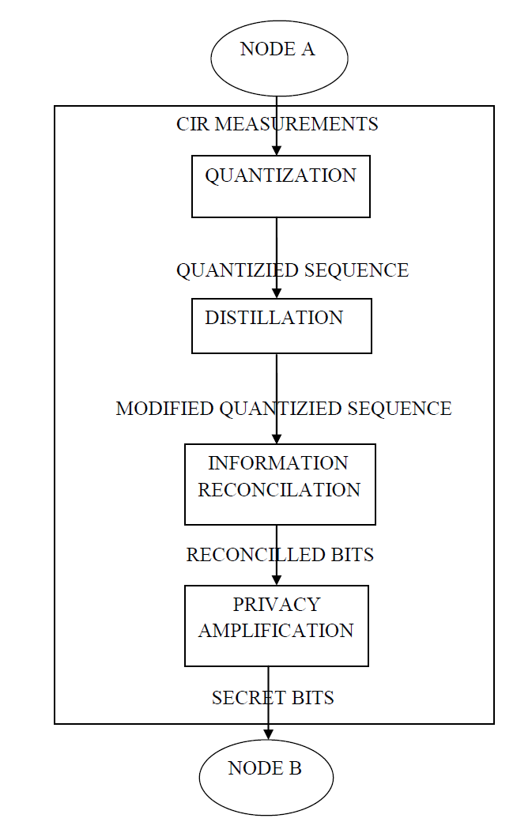
ARCHITECTURE DIAGRAM

Slide 10
NUMBER OF MODULES
Quantization
Distillation
Information Reconciliation
Prediction & Evaluation

Slide 11
MODULE DESCRIPTION
QUANTIZATION
Packets are exchanged between two nodes each node quantizes its time series to generate an initial secret bit sequence.
Based on a threshold value, quantization will be done.
Finally we will measure CIR from different packets

Slide 12
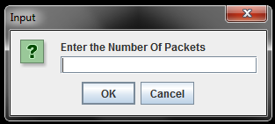
SNAPSHOT FOR QUANTIZATION
GENERATE PACKET

Slide 13
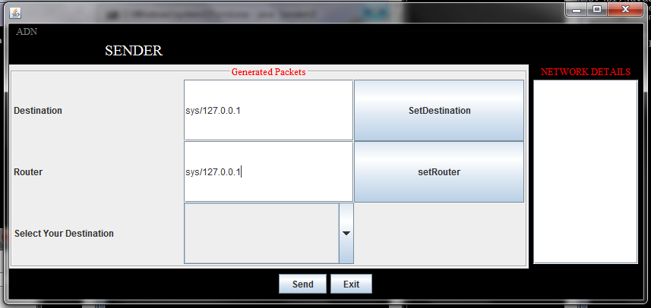
SEND GENERATED PACKETS

Slide 14
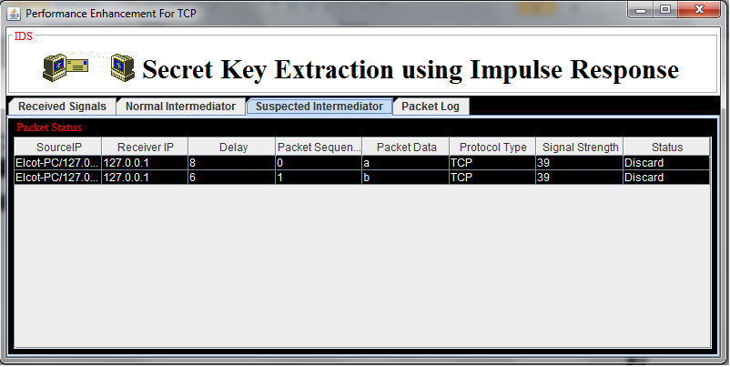
QUANTIZE GENERATED PACKETS

Slide 15
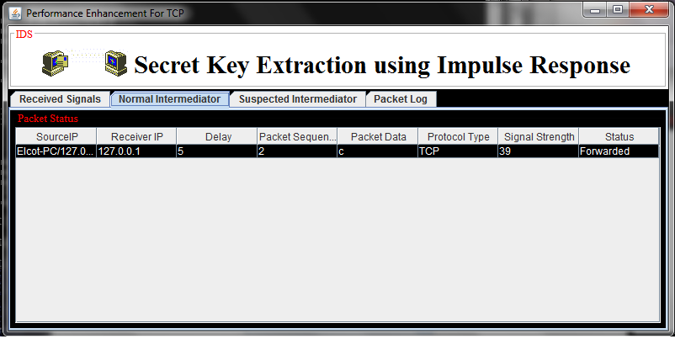
PACKET FORWARD STATUS

Slide 16
DISTILLATION
To address the problem of very high bit mismatch rates, we augment the secret key extraction process with the distillation stage.
Distillation ensures that the percentage of mismatching bits is low enough for information reconciliation to correct the differences without revealing all the extracted bits

Slide 17
INFORMATION RECONCILIATION
In this unit each node divides the bit stream into small blocks and compute the parity information and compares with other node
For each mismatch, Node performs a binary search on the block to find if a few bits can be changed to make the block match the parity.

Slide 18
PREDICTION & EVALUATION
In prediction module to prevent the channel attacker by using a channel impulse response.
In the evaluation module, we compare the performance of ASBG with other existing schemes in terms of entropy, secret bit rate, and bit mismatch rate.
Finally compares the results with RSS and Channel Impulse Response.

Slide 19
LITERATURE SURVEY
NAME OF THE AUTHOR | YEAR | NAME OF THE JOURNAL | WORK CARRIED OUT | ALGORITHM/DRAWBACK
Sriram Nandha Premnath, Suman Jana and Jessica Croft | 2013 | IEEE Transaction on mobile computing | Based on RSS measurements, generate the secret key | Not suitable for static environments
Qian Wang, Member, Kaihe Xu and Kui Ren | 2012 | IEEE Journal on selected areas in communications | Novel cooperative key generation protocol is developed to facilitate high-rate key generation | Mainly depends on in between relay nodes
Neal Patwari, and Sneha Kumar Kasera | 2010 | IEEE Transaction on mobile computing | Measure the noisy channel measurements from the sender and receiver node | High rate uncorrelated bit extraction (HRUBE) framework

Slide 20
NAME OF THE AUTHOR | YEAR | NAME OF THE JOURNAL | WORK CARRIED OUT | ALGORITHM/ DRAWBACK
John E. Hershey, Amer A. Hassan, and Rao Yarlagadda | 2010 | IEEE Transactions on communication | Send unmodulated continuous wave signal and measure the phase difference between the two node | For generate secret key they use separate technique

Slide 21
REFERENCE
[1] Sriram Nandha Premnath, Suman Jana, PrarthanaLakshmane Gowda and
Mike Clark,” Secret Key Extraction from Wireless Signal Strength in Real
Environments,” IEEE Transactions On Mobile Computing, Vol. 12, No. 5,
May 2013.
[2] John E. Hershey, Amer A. Hassan, and Rao Yarlagadda,” Unconventional
Cryptographic Keying Variable Management,” IEEE Transactions On
Communications, Vol. 43, No. 1,January 2010.
[3] Neal Patwari, Jessica Croft, Suman Jana, and Sneha Kumar Kasera,” High-
Rate Uncorrelated Bit Extraction for Shared Secret Key Generation,” IEEE
Transactions On MobileComputing, Vol. 9, No. 1, January 2010.

Slide 22
[4] Theodore S. Rappaport “wireless communications principles
and practices, Second edition”.
[5] NIST,A Statistical Test Suite for Random and pseudorandom number
generators for Cryptographic Applications,” http://
csrc.nist.gov/publications/nistpubs/800-22/sp-800-22-051501. pdf, 2001.

Slide 23
THANK YOU!!!

